Slide 1


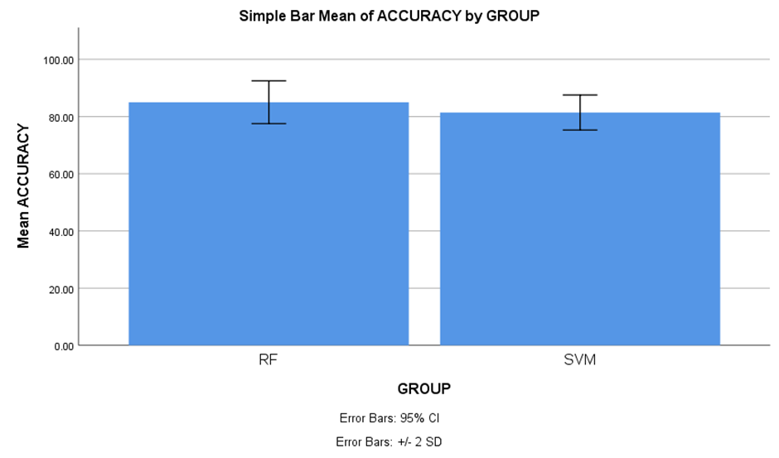
Name: B. Hemanth Chowdary Register Number: 192211206
Guided by Dr. Nelson Kennedy Babu C
Ms. Poorani.S
Guided by Dr. Mary Valantina. G
Insurance Cold Calling Optimization Using Random Forest Regression Compared with
Support Vector Machine For Improved Accuracy
INTRODUCTION
The primary aim of this research is to optimize the cold-calling process for insurance companies, focusing on improving efficiency, reducing resource consumption, and enhancing overall productivity. By refining cold-calling strategies, insurance companies can more effectively attract new customers and maximize profits.
To identify factors like call timing, audience demographics, and communication skills that affect cold-calling success and to evaluate the effectiveness of various machine learning techniques, such as Random Forest Regression and Support vector machine, in streamlining marketing and sales initiatives for insurance companies.
Use machine learning algorithms, such as Random Forest Regression and Support vector machine, to analyze and optimize cold-calling strategies.
Enhanced sales outcomes for insurance companies, with higher conversion rates and increased customer satisfaction, resulting from more targeted and data-driven cold-calling methods.
Fig 1. Insurance agent’s prospect by Brian Tracy
MATERIALS AND METHODS
Random Forest Regression
Import dataset and required libraries
Pre-Process data to handle missing values
Split dataset into Training(75%) and Test Set(25%)
Implement algorithms
Build Classifier models for each algorithm based on the training set
Support vector machine
Data Collection
Random Forest Regression algorithm achieves higher accuracy
Perform Comparison evaluation of the results obtained for each classifier using IBM SPSS V25
Test the Classifier models using the test set
Process of evaluating and Optimizing Insurance Cold Calling
RESULTS
Table 1. The Mean Accuracy of the Random Forest Regression algorithm and Support vector machine
Groups |  | N | Mean | STD. Deviation | STD. Error Mean
Accuracy | Random Forest Regression | 10 | 85.4000 | 3.74166 | 1.18322
 | Support Vector Machine | 10 | 81.6000 | 3.06232 | 0.96839
The figure shows the mean Accuracy of the Random forest regression which is greater than the Support vector machine algorithm. X axis is Random forest regression vs Support vector machine, Y axis is Mean Accuracy. Error bar is +/-2 SD
Fig 2. Comparison of the Mean Accuracy Graph
DISCUSSION AND CONCLUSION
Random Forest Regression achieved higher accuracy (85.4%) compared to Support Vector Machine (81.6%) in predicting insurance cold-call outcomes
Statistical analysis revealed differences in standard deviation and mean standard error between Random Forest Regression and Support Vector Machine, indicating variability in predictions and model stability
Independent variable analysis showed a significant difference in accuracy rates between Random Forest Regression and Support Vector Machine, with Random Forest Regression performing better
The study suggests potential for insurance firms to enhance customer acquisition and profitability through optimized cold-calling techniques and data-driven insights
Random Forest Regression's alignment with the procedural nature of cold calling enhances its effectiveness, while Support Vector Machine's interpretability may be advantageous in certain scenarios
BIBLIOGRAPHY
Gearheart, James. 2020. End-to-End Data Science with SAS: A Hands-On Programming Guide. SAS Institute. DOI: 10.1111/insr.12423
Jayadeva, Reshma Khemchandani, and Suresh Chandra. 2023. Twin Support Vector Machines: Models, Extensions and Applications. Springer. DOI: 10.1007/978-3-319-46186-1
Joachims, Thorsten. 2020. Learning to Classify Text Using Support Vector Machines. Springer Science & Business Media. DOI: 10.1007/978-1-4615-0907-3
Watt, Jeremy, Reza Borhani, and Aggelos K. Katsaggelos. 2020. Machine Learning Refined: Foundations, Algorithms, and Applications. DOI: 10.1017/9781108690935
Zhang, Wei, Junchao Wang, Fang Xie, Xinghui Wang, Shanshan Dong, Nan Luo, Feng Li, and Yuewei Li. 2024. “Development and Validation of Machine Learning Models to Predict Frailty Risk for Elderly.” Journal of Advanced Nursing, April. DOI: https://doi.org/10.1111/jan.16192
León, Raúl, María Jesús Muñoz-Torres, and Jose M. Moneva. 2021. Modeling and Simulation in Engineering, Economics and Management: International Conference, MS 2016, Teruel, Spain, July 4-5, 2023, Proceedings. Springer. DOI: https://doi.org/10.1007/978-3-319-40506-3

